Slide 1

Notes:
Notes go here

Slide 2


Slide 3
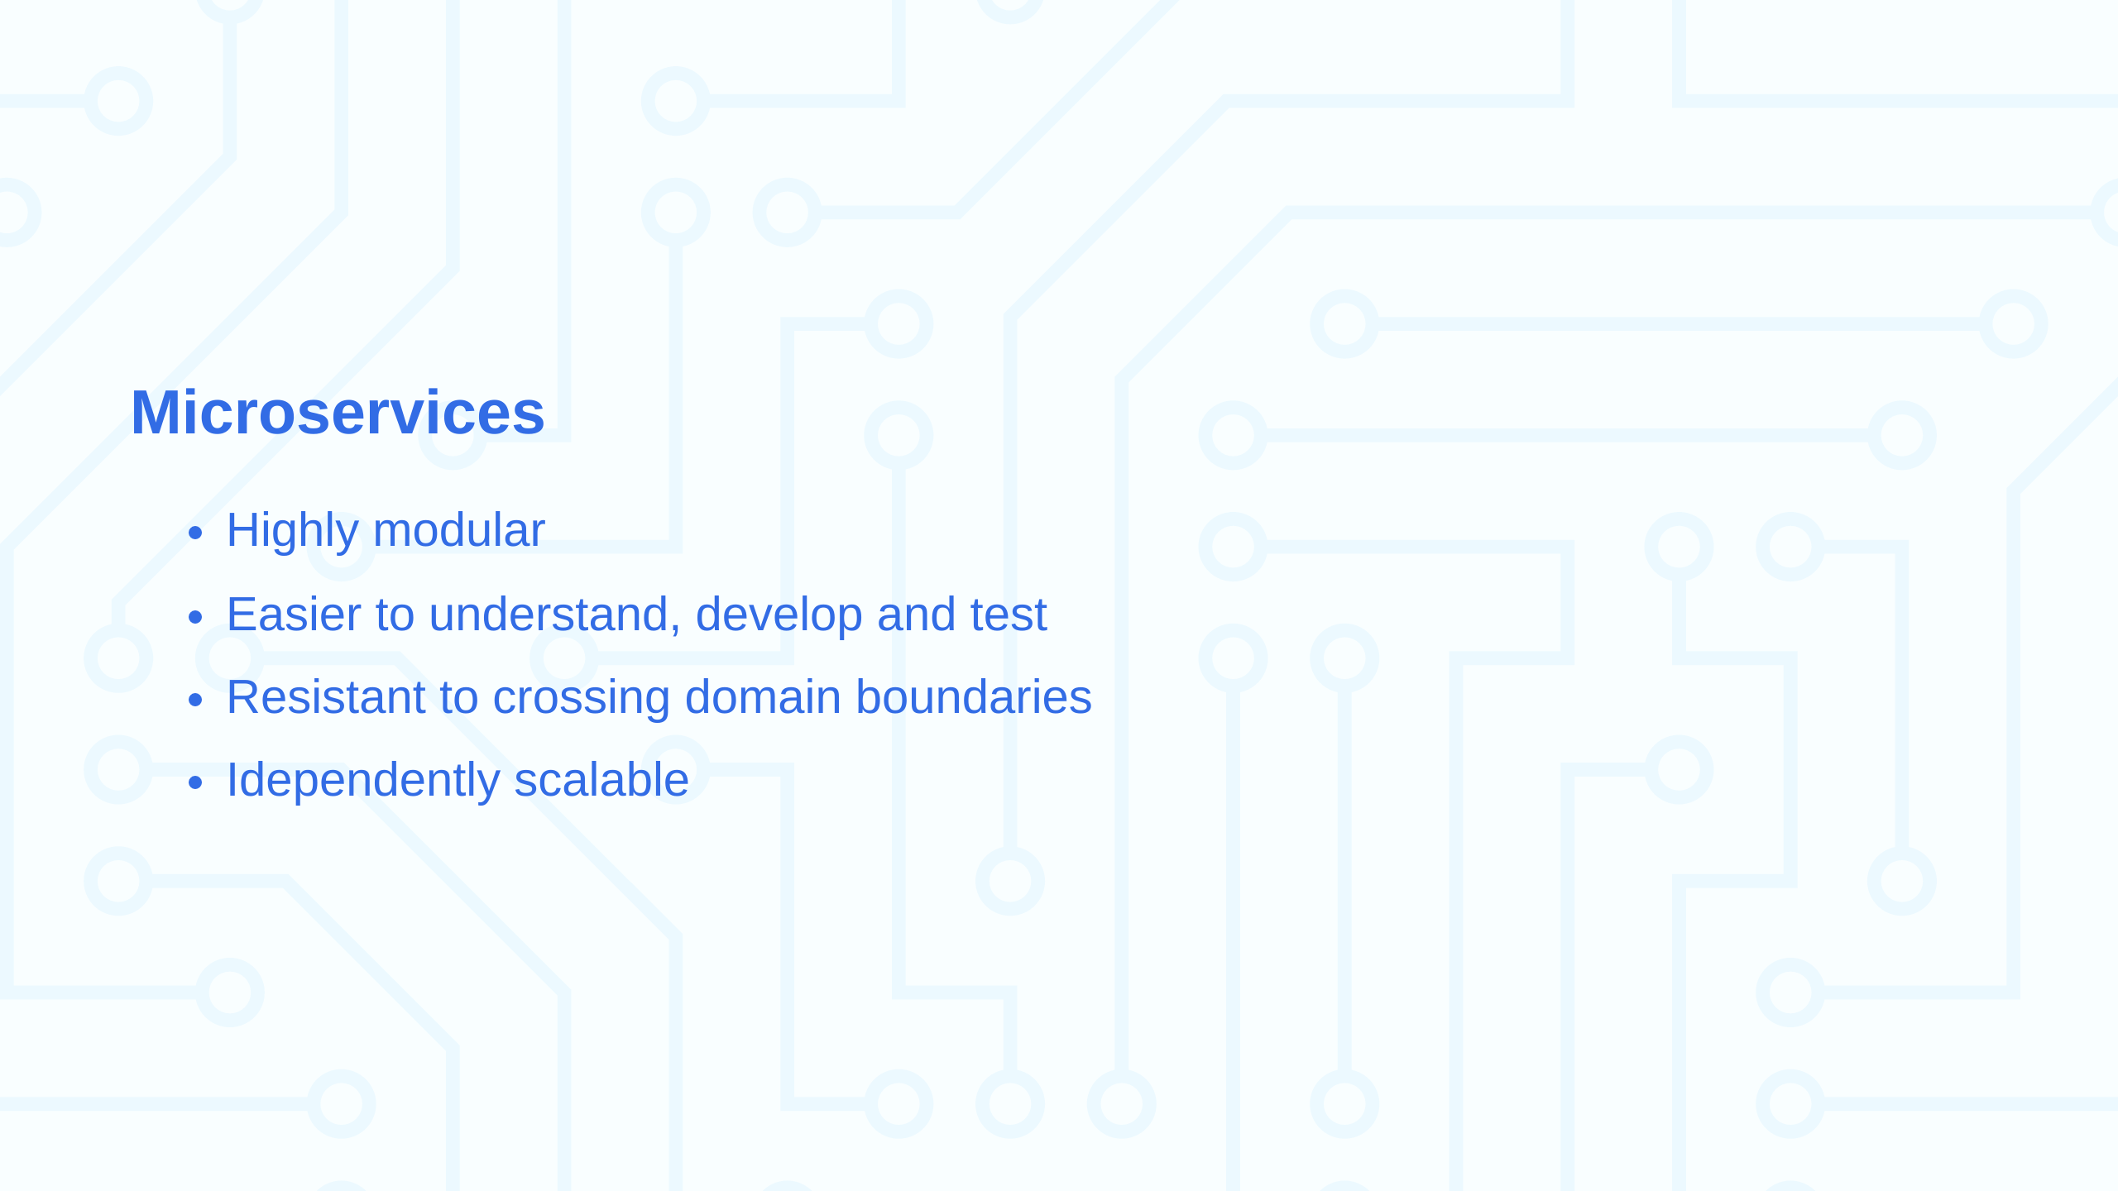

Slide 4
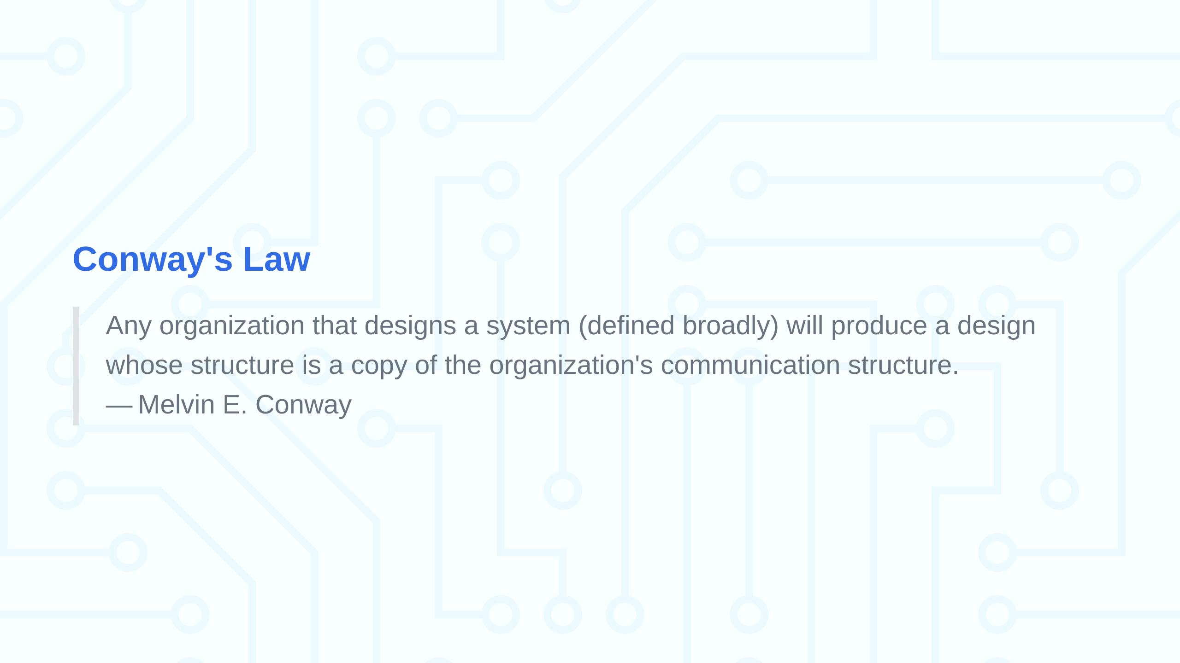

Slide 5
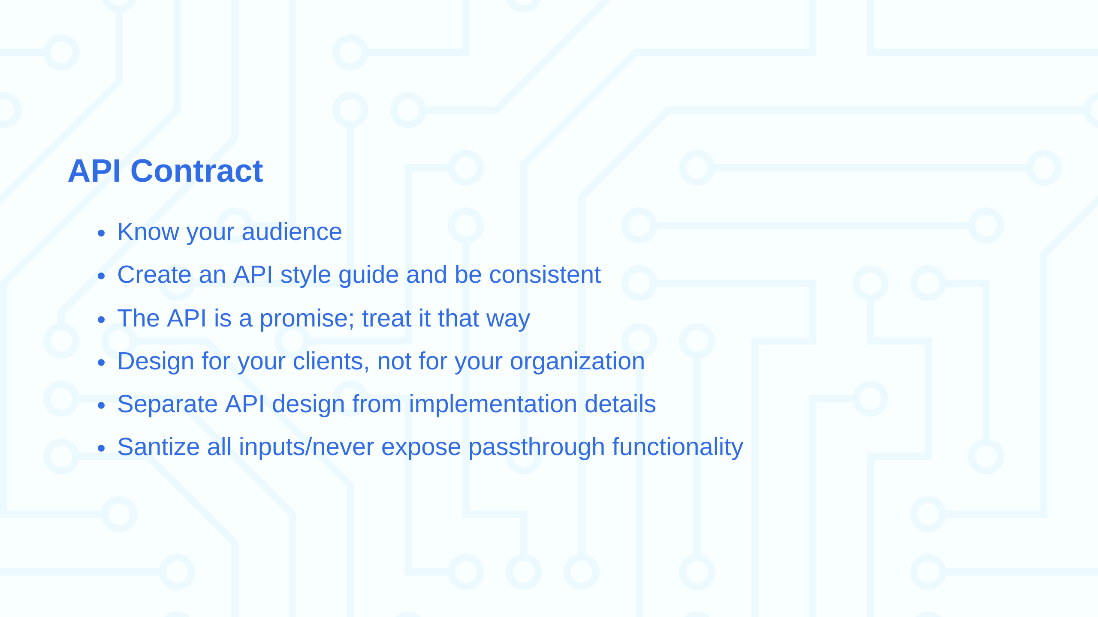
Notes:
The organization must be compatible with the product architecture

Slide 6
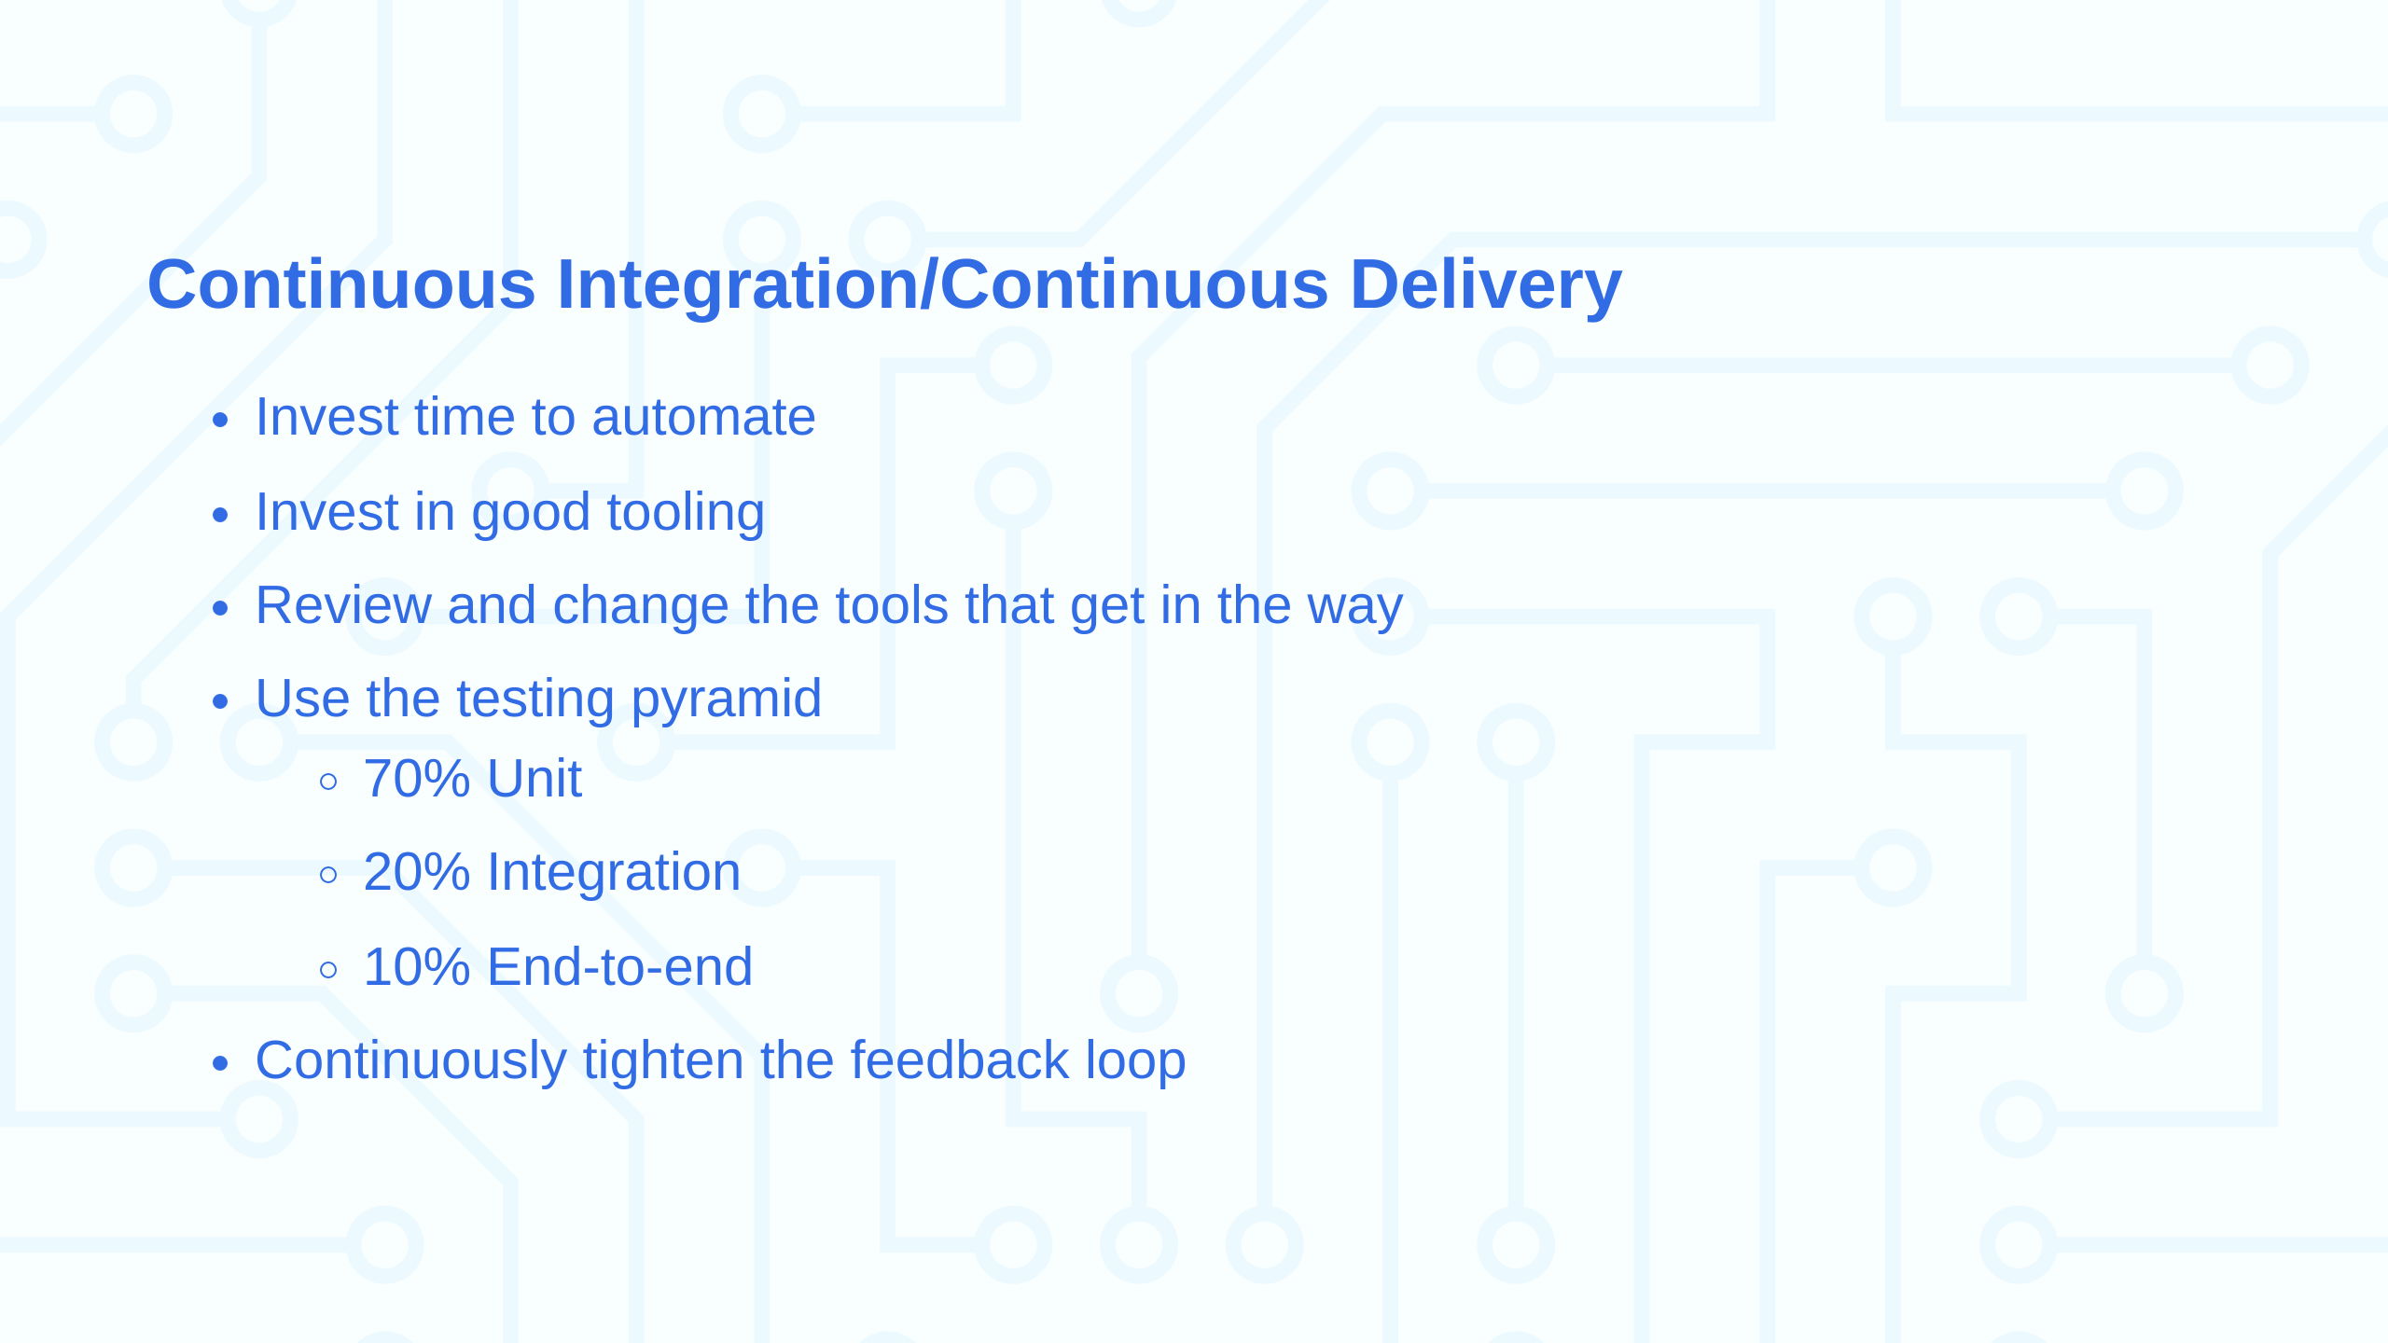

Slide 7


Slide 8
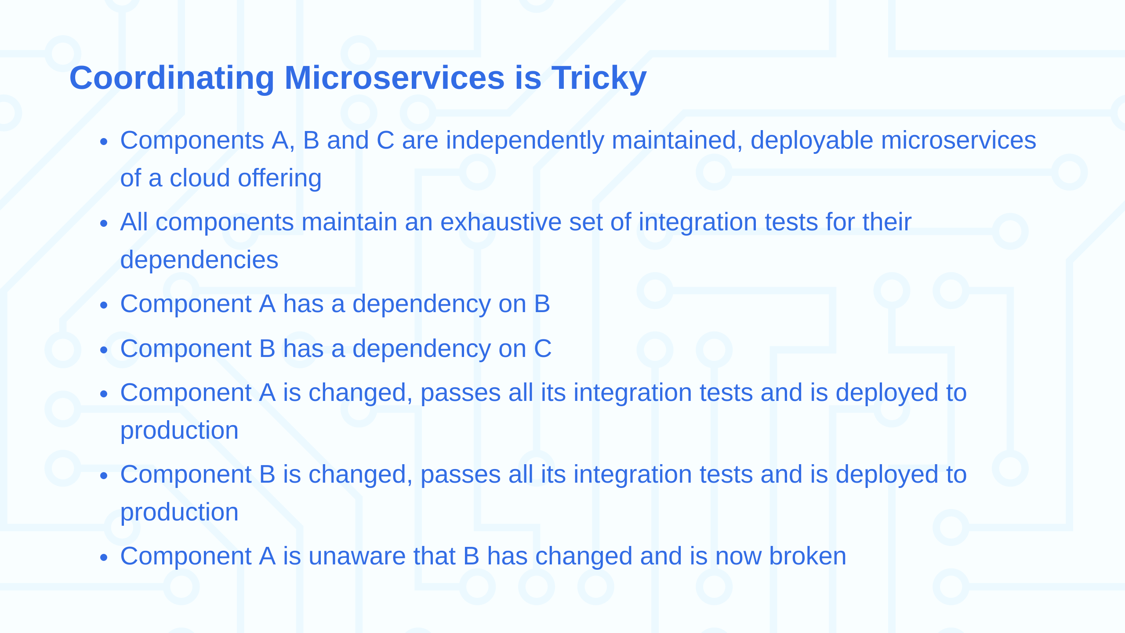

Slide 9
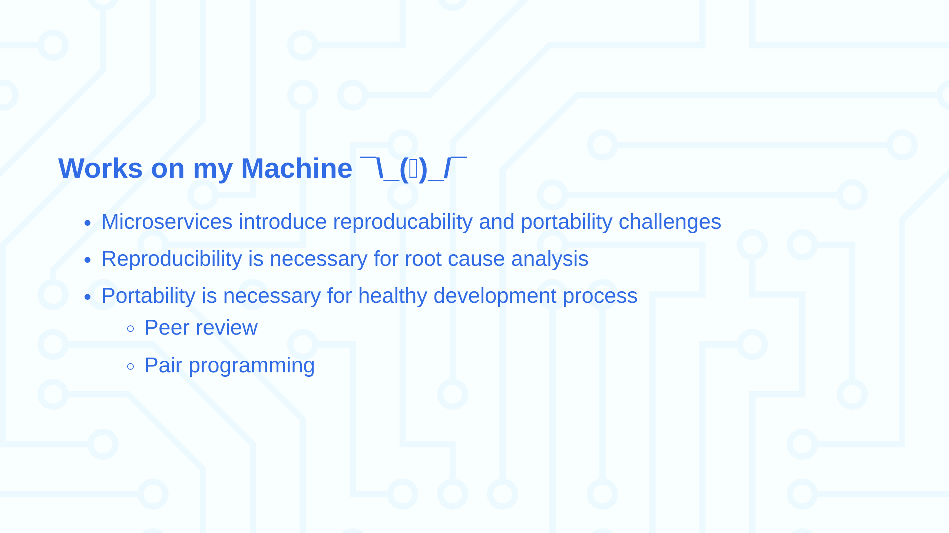
Notes:
Reproducability - a given set of inputs will always produce the same outputs Portability - can run on any machine

Slide 10


Slide 11
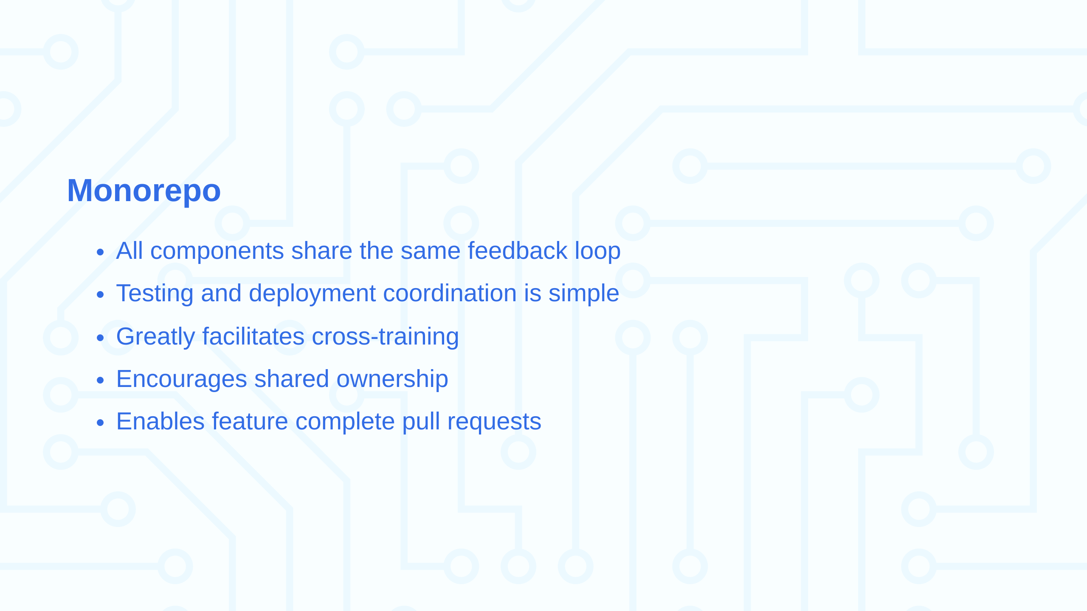

Slide 12
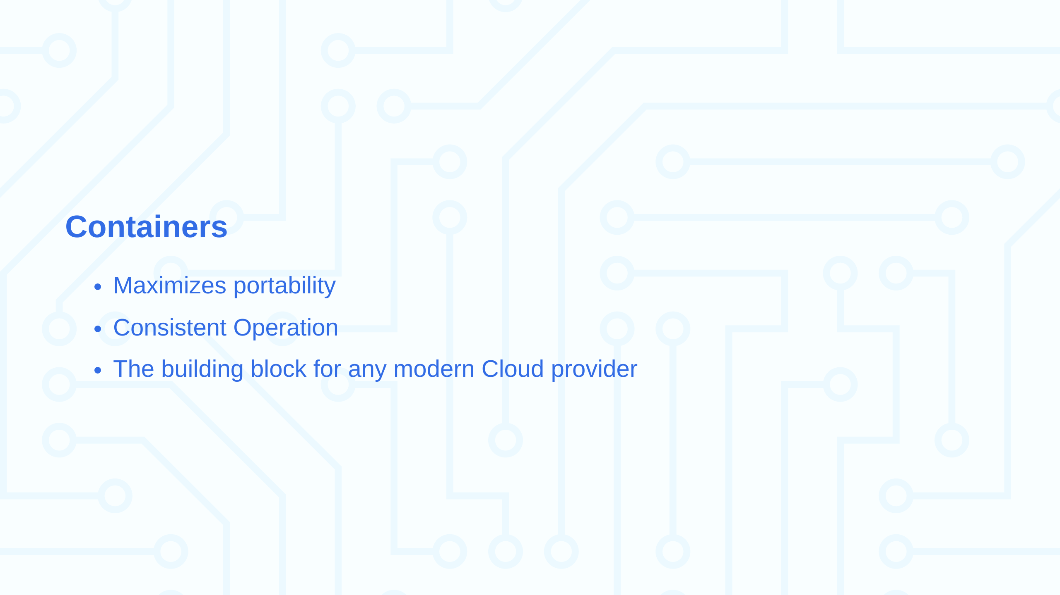

Slide 13


Slide 14
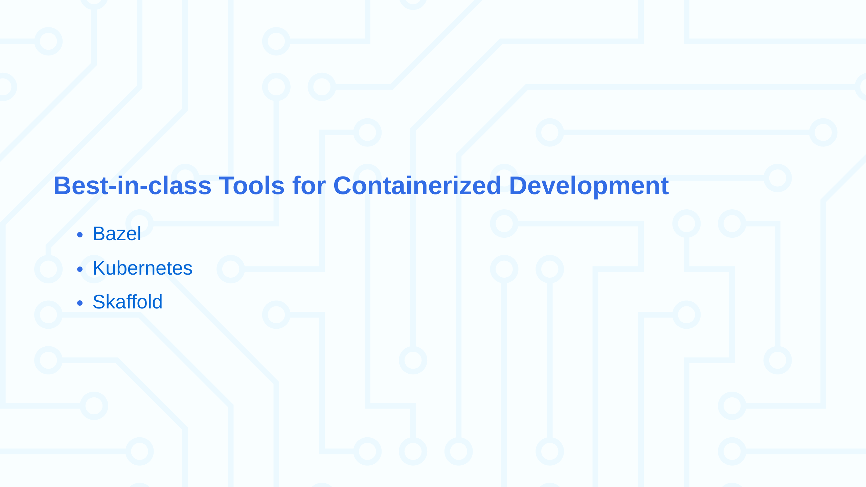

Slide 15


Slide 16
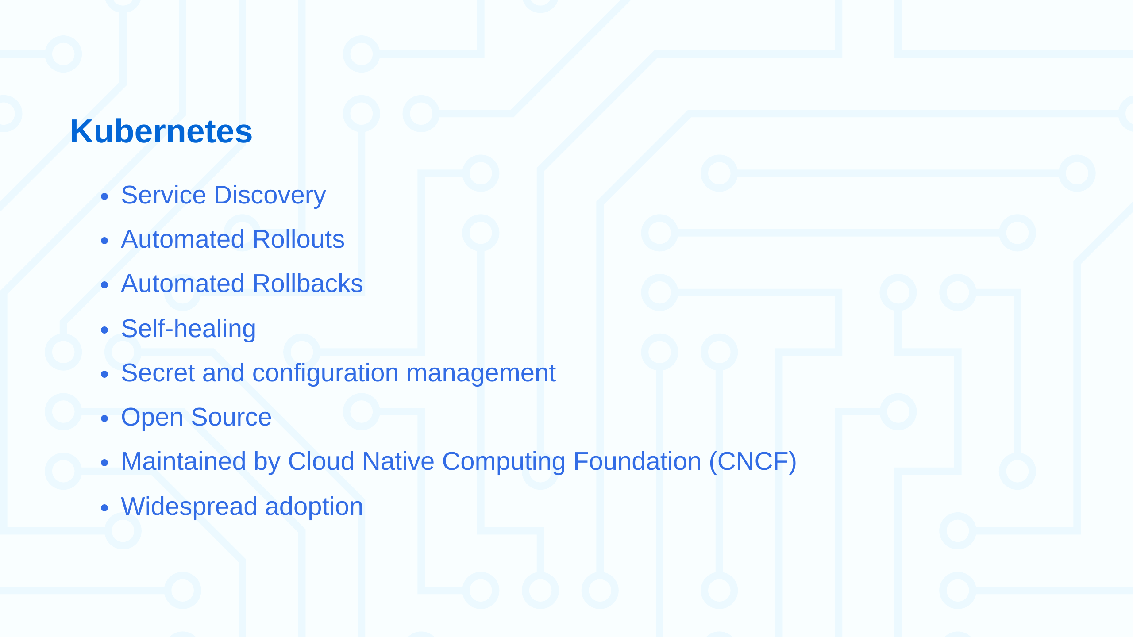
Notes:
74% or organizations surveyed run k8s in production

Slide 17


Slide 18
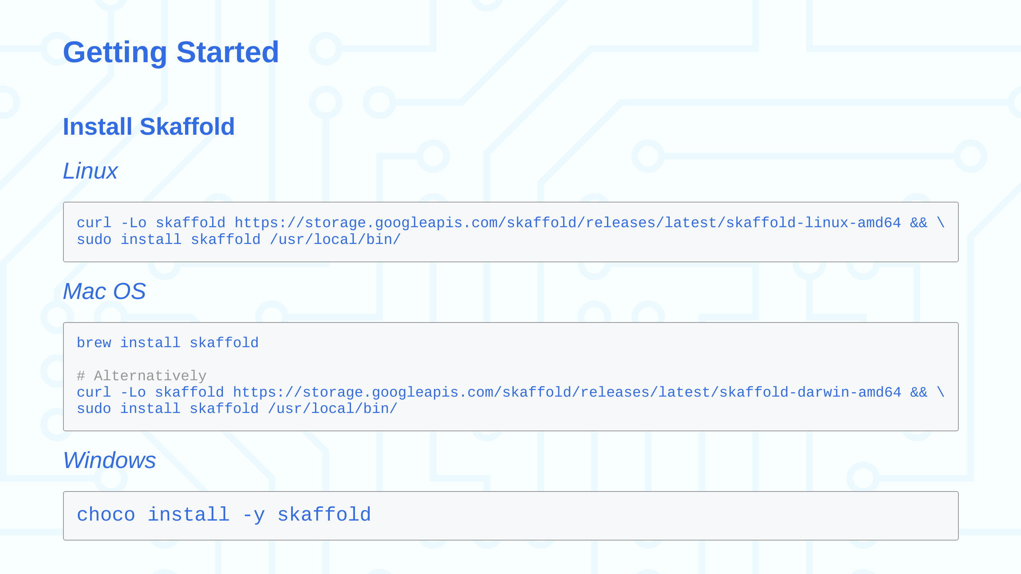

Slide 19
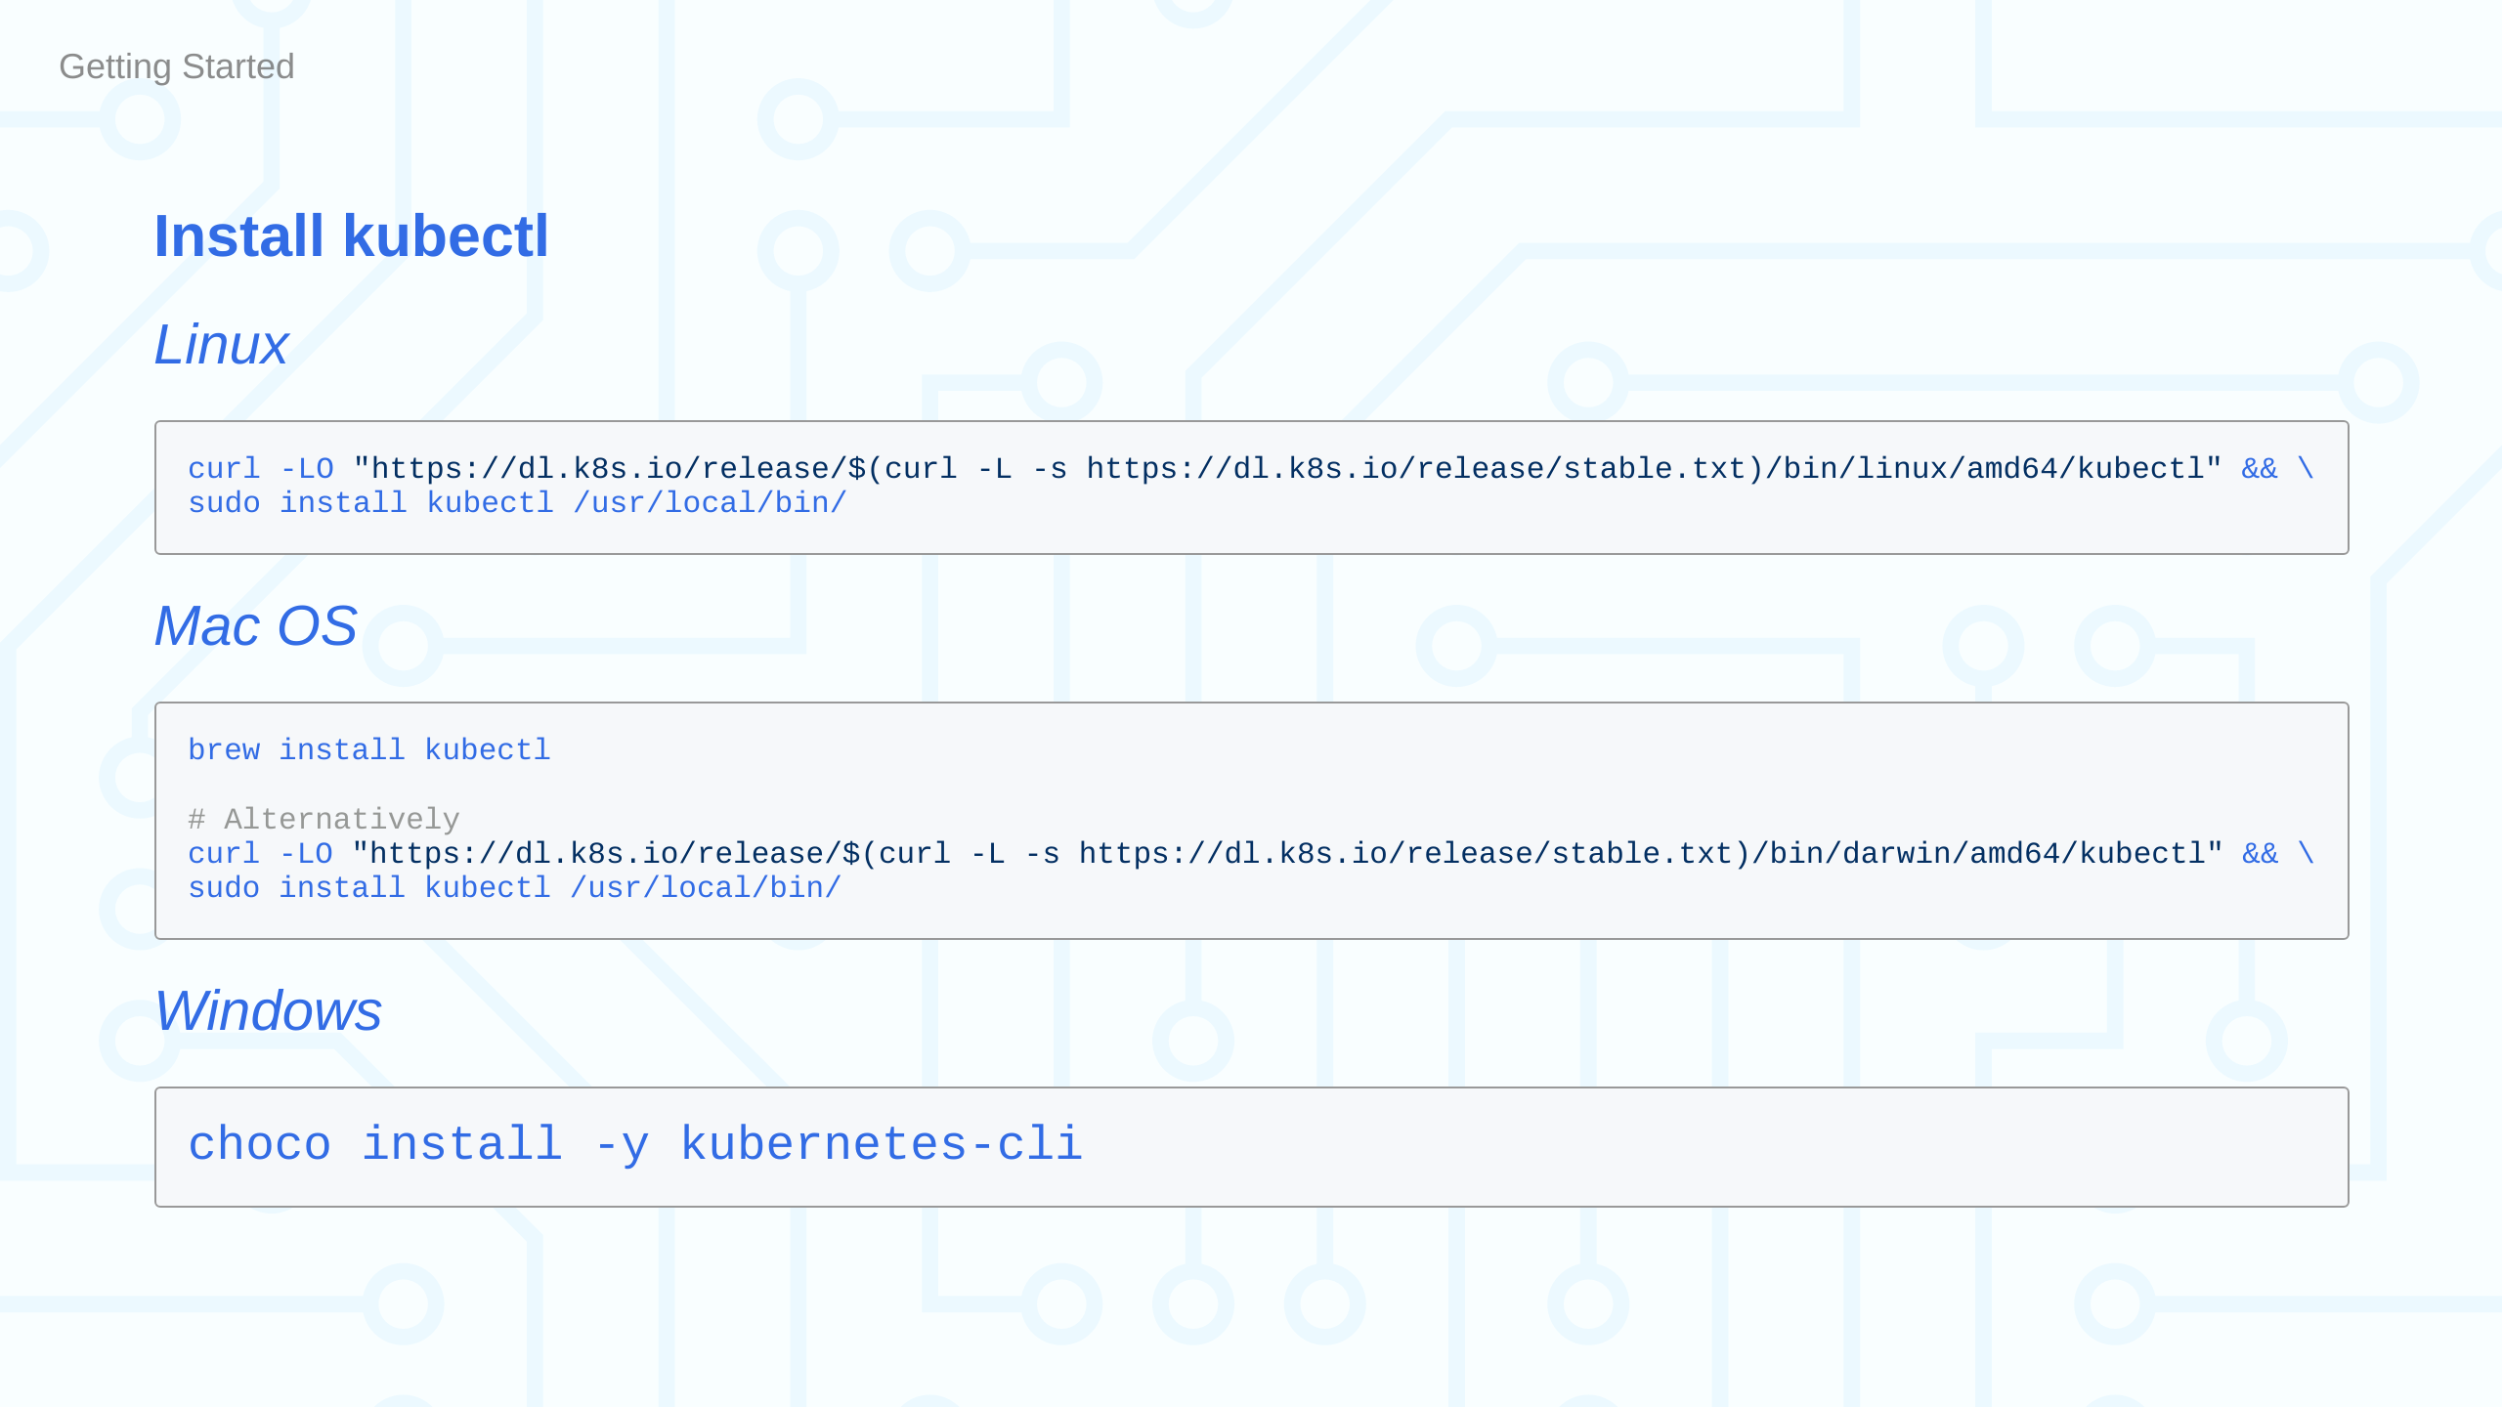

Slide 20
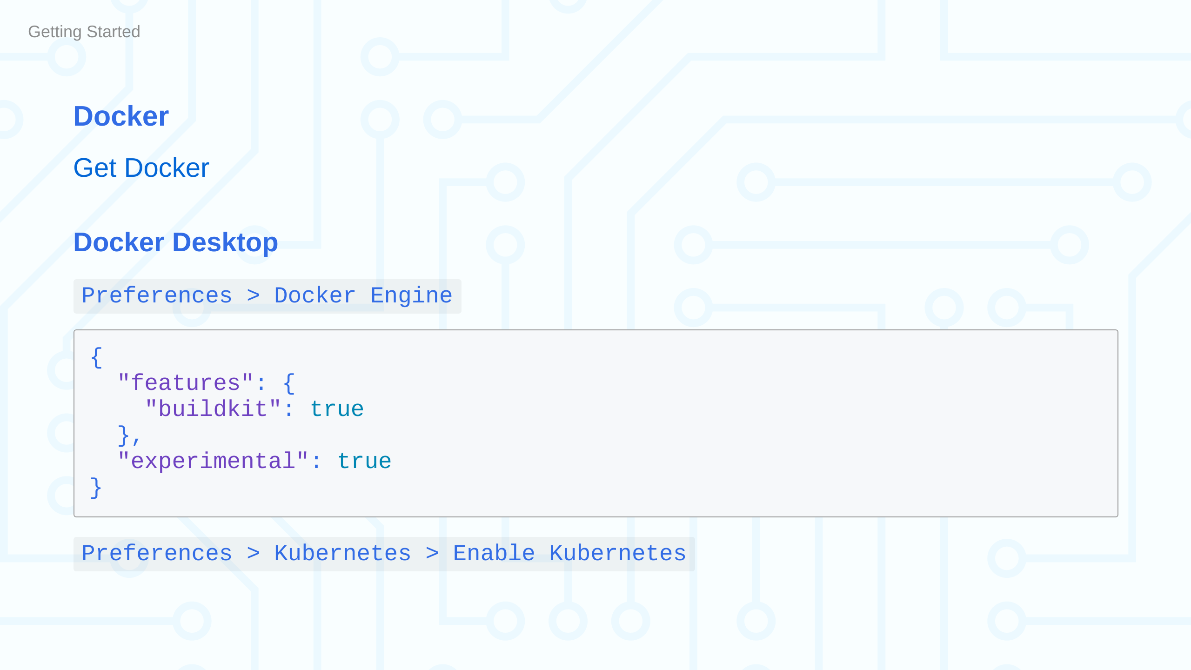

Slide 21
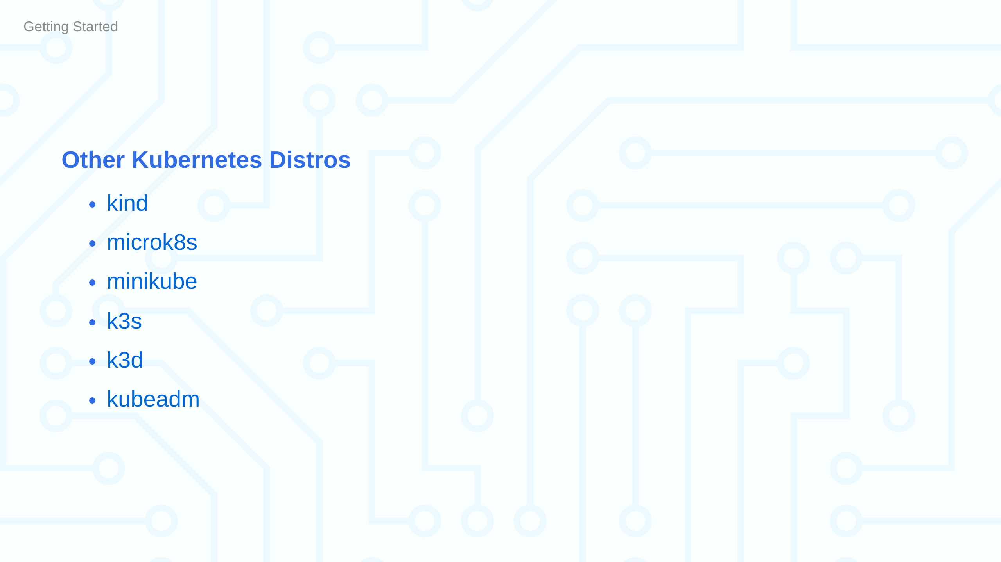

Slide 22


Slide 23


